Slide 1

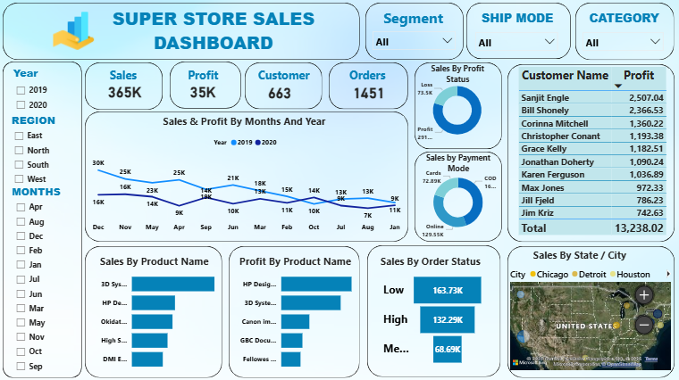
Super Store Dashboard Using Microsoft Power BI
Brief:
The analysis highlights overall profitable business performance with key contributions from specific customers, products, and regions.
Data-driven insights from sales, profit, and delivery trends support better decision-making to improve efficiency and revenue growth.

Slide 2
Overview
Purpose
Problem Statement
Datasets Used
Column Descriptions
ETL Process (Extract, Transform, Load)
Data Model Overview
Relationship diagram and explanation
Calculated Columns
Key Measures & KPIs
Visual insights
Conclusion
Recommendations

Slide 3
Purpose
Sales Performance Analysis:
This dataset is used to analyze total sales and profit to understand overall business performance.
Customer Behaviour Analysis:
This dataset helps identify top customers, customer profitability, and purchasing patterns.
Product & Category Analysis:
This dataset is used to compare product categories and products to find best-selling and loss-making items.
Time & Delivery Analysis:
This dataset helps analyse sales trends over months and years and evaluate delivery performance using order and ship dates.

Slide 4
Problem Statement
The organization lacks a clear understanding of overall sales and profit performance across different regions and time periods.
There is no systematic way to identify top-performing and loss-making customers, which affects customer relationship and profitability decisions.
Product and category-level performance is not clearly analyzed, making it difficult to optimize inventory and product strategy.
Delivery efficiency and order fulfillment performance are not monitored effectively, leading to potential delays and customer dissatisfaction.
Decision-makers do not have an interactive and visual dashboard to track key business metrics and support data-driven decision-making.
The business does not have a consolidated view of sales, profit, and order trends to evaluate overall performance effectively.
There is difficulty in identifying profitable and loss-making customers and products due to the absence of structured analytical insights.
Delivery timelines and order status are not systematically analyzed, making it challenging to improve operational efficiency and customer satisfaction.

Slide 5
Datasets Used
Super Store_Sales_Dataset

Slide 6
Columns Descriptions
Order ID – A unique identifier assigned to each customer order.
Order Date – The date on which the customer placed the order.
Ship Date – The date on which the order was shipped to the customer.
Ship Mode – The method or type of shipping used for order delivery.
Customer ID – A unique identifier assigned to each customer.
Customer Name – The full name of the customer who placed the order.
Segment – The classification of customers based on business type.
Country – The country where the order was placed or delivered.
City – The city where the customer or order is located.
State – The state where the customer or order is located.
Region – The geographical region assigned for sales analysis.
Product ID – A unique identifier assigned to each product.
Category – The broad classification of products sold by the store.
Product Name – The name or description of the product sold.
Sales – The total revenue generated from the sale of a product.
Quantity – The number of units of a product sold in an order.
Profit – The financial gain or loss resulting from the sale.
Clothing).

Slide 7
Payment Mode – The method used by the customer to complete the payment.
Profit Margin – The percentage of profit earned relative to sales.
Profit Status – Indicates whether the transaction resulted in profit or loss.
Delivery Days – The number of days taken to deliver the order.
Year – The year in which the order was placed.
Delivery Status – Indicates whether the order was delivered on time or delayed.
Order Status – The current stage of the order in the fulfilment process.
Customer Profitability – Indicates whether a customer is profitable or loss-making.
Sales Status – Indicates the performance level of a sale based on sales value.
Months – The month in which the order was placed for trend analysis.

Slide 8
Data Preprocessing
Extract – Imported datasets :
Super Store_Sales_Dataset
Transform :
Renamed and standardized column names
Removed nulls and irrelevant columns
Merged tables
Created custom columns
Removed duplicates
Filtered unnecessary records
Load :
Loaded all transformed tables into Power BI model
Created relationships
Measure Created:

Slide 9
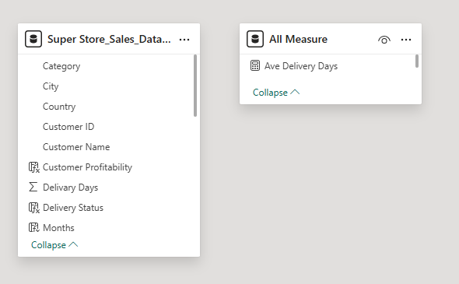
Data Model Overview

Slide 10

Calculated Columns
Profit Margin – Calculates the percentage of profit earned from total sales.
Profit Status – Indicates whether an order resulted in profit or loss based on profit value.
Delivery Days – Calculates the number of days taken between order date and ship date.
Year – Extracts the year from the order date for yearly analysis.
Delivery Status – Classifies orders as on-time or delayed based on delivery days.
Order Status – Represents the current stage of the order in the fulfilment process.
Customer Profitability – Identifies whether a customer is profitable or loss-making overall.
Sales Status – Categorizes sales as high or low based on predefined sales thresholds.
Months – Extracts the month name from the order date for monthly trend analysis.

Slide 11
Key Measures
Total Sales: Represents the total revenue generated from all customer orders.
Formula = SUM('Super Store_Sales_Dataset'[Sales])
Total Profit: Shows the overall profit or loss earned from all sales transactions.
Formula = SUM('Super Store_Sales_Dataset'[Profit])
Total Orders: Counts the total number of unique orders placed by customers.
Formula = DISTINCTCOUNT('Super Store_Sales_Dataset'[Order ID])
Total Customers: Counts the total number of unique customers in the dataset.
Formula = DISTINCTCOUNT('Super Store_Sales_Dataset'[Customer ID])

Slide 12

Slicer Analysis
Analysis:
This analysis helps understand how sales and profit vary across different customer segments.
This analysis evaluates the impact of different shipping modes on delivery performance and profitability.
This analysis compares product categories to identify the best-performing and least-performing categories.
This analysis shows how applying segment, ship mode, and category filters together affects overall business performance.

Slide 13
Cards Analysis
Analysis :
Total Products (25K)-Indicates a wide product portfolio, enabling strong assortment and customer choice.
Total Revenue (17M)-Shows strong financial performance and high sales volume across the business.
Shipping Charges(920K)-Shipping Charges represent the total amount spent on delivering orders to customers across all regions.
Transactions (25K)-Suggests most customers have made at least one purchase, showing high engagement.
Total Clicks (1M)-A large number of website/app visits indicates strong digital presence and customer interest, though conversion optimization may increase purchases further.

Slide 14
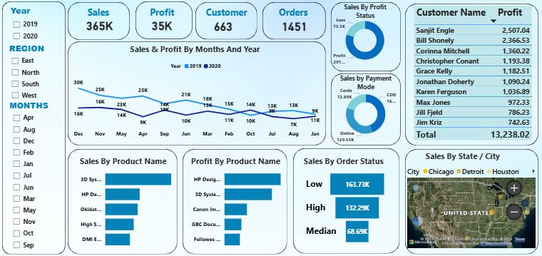
Main KPI, Region, Year & Month Wise Performance
The business achieved total sales of 365K with a profit of 35K, indicating overall profitable performance.
Sales performance in 2019 is higher than in 2020, showing a noticeable decline in the later year.
Monthly analysis reveals that sales peak in months like May and November, while some mid-year months show lower performance.
The profit status distribution shows that most sales transactions are profitable, with a smaller portion resulting in losses.
Online payment mode contributes the highest share of total sales compared to COD and other payment methods.
A few customers contribute significantly to profit, with Sanjit Engle and Bill Shonely emerging as top profit-generating customers.
Product-wise analysis shows that a limited number of products drive the majority of sales and profit, following a Pareto pattern.
City-wise sales analysis indicates that major cities such as Chicago and Detroit contribute a large share of total sales, highlighting key regional markets.

Slide 15
Conclusion
The overall analysis shows that the business is profitable, with strong total sales and a positive profit margin.
Sales trends indicate better performance in certain months and a decline in later periods, highlighting opportunities for seasonal planning.
Customer and product analysis reveals that a small group of customers and products contributes significantly to overall profit.
Online payment mode and major cities play a key role in driving sales, indicating preferred customer behavior and strong regional markets.
Delivery and order performance insights suggest the need for continuous monitoring to improve operational efficiency and customer satisfaction.

Slide 16

Recommendation
The business should focus on high-performing months by planning targeted promotions and inventory availability during peak sales periods.
Profitable customers and top-performing products should be prioritized through loyalty programs and personalized offers to maximize revenue.
Loss-making products and low-profit transactions should be reviewed to optimize pricing, cost structure, or discontinue underperforming items.
Online payment methods should be further promoted, as they contribute the highest share of sales and improve transaction efficiency.
Delivery performance should be closely monitored and optimized by improving shipping processes to enhance customer satisfaction and reduce delays.

Slide 17


